Slide 1
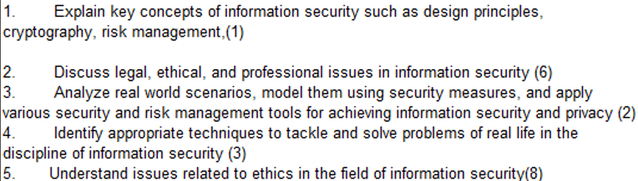
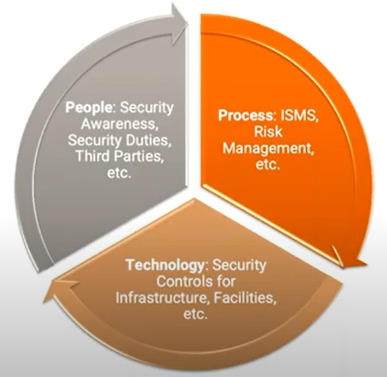
CS 3002 Information Security
Fall 2022
Week # 8 – Lecture # 19, 20, 21
14th, 15th, 16th Rabi ul Awwal, 1444
11th, 12th, 13th October 2022
Dr. Nadeem Kafi Khan

Slide 2
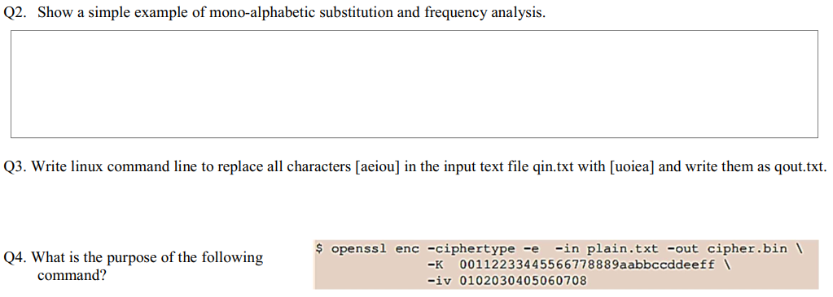
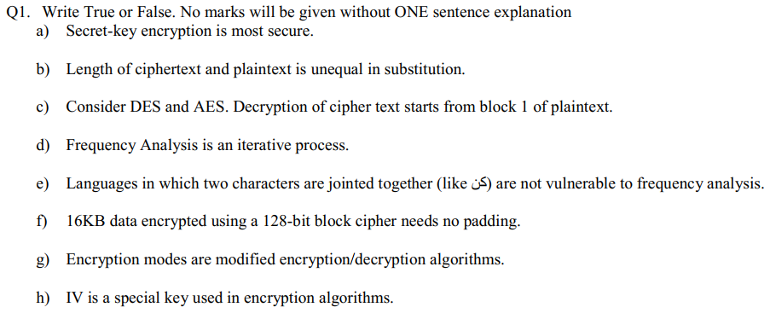

Lecture # 19 - LAB
Lab Exam

Slide 3
Lecture # 20
Identify, Credential and Access Management (ICAM)
Figure 4.2 discussed thoroughly and section was given as reading assignment
Database Security
RDBMS
SQL (as code) execution
Web Application scenario discussed for SQL Injection

Slide 4

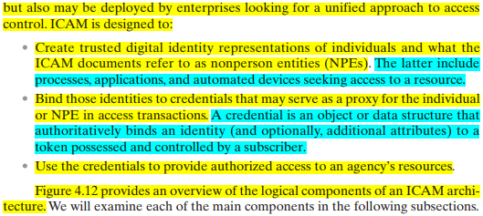

Slide 5
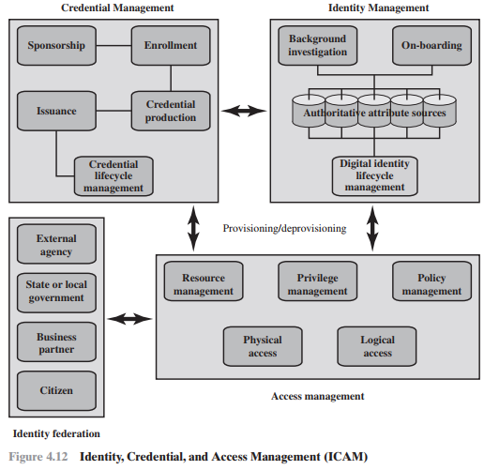
Self Reading as per the explanation during the lecture

Slide 6
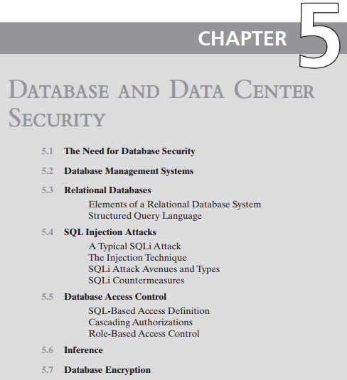
Self Study

Slide 7
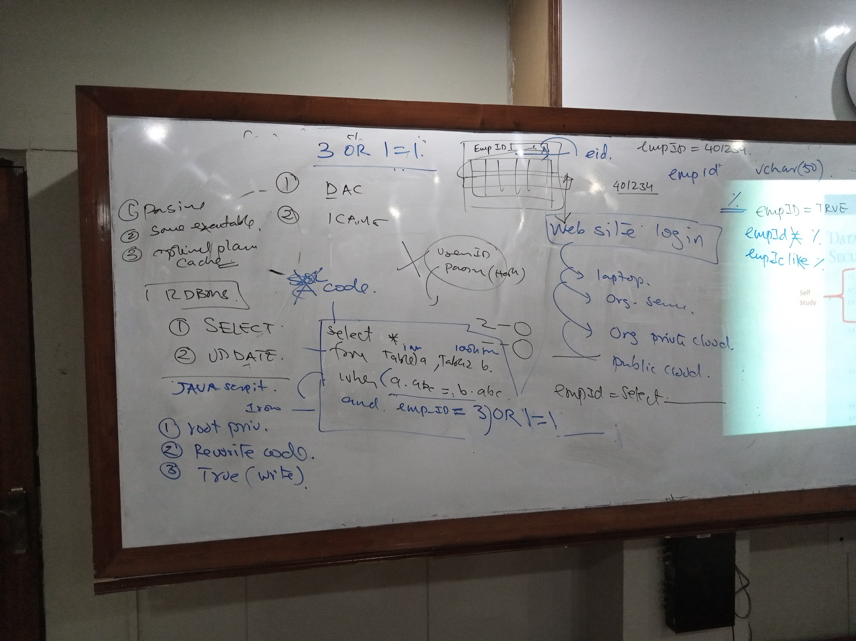

Slide 8
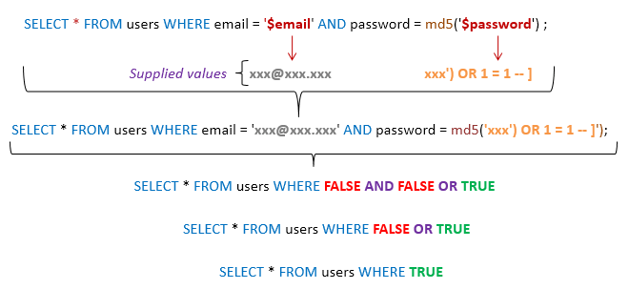

Slide 9
Lecture # 21
Database security
SQL Injection Attack
Steps involved in a typical SQL Injection attack
The Injection techniques
SQL Injection attack types
In-band, out-of-band, inferential

Slide 10
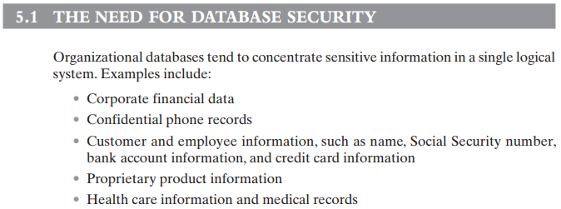

Slide 11
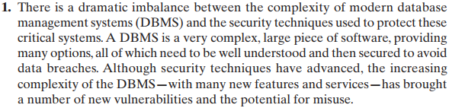
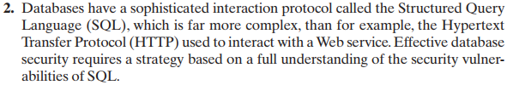
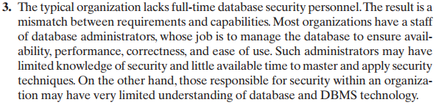
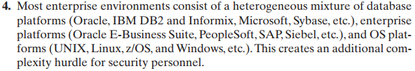

Slide 12
Important SQL Syntax
COMMENTS: --
Example: SELECT * FROM `table` --selects everything
LOGIC: ‘a’=‘a’
Example: SELECT * FROM `table` WHERE ‘a’=‘a’
MULTI STATEMENTS: S1; S2
Example: SELECT * FROM `table`; DROP TABLE `table`;

Slide 13
The SQL injection (SQLi) attack is one of the most prevalent and dangerous network-based security threats.
An SQLi attack is designed to exploit the nature of Web application pages.
Most current websites have dynamic components and content. Many such pages ask for information, such as location, personal identity information, and credit card information. This dynamic content is usually transferred to and from back-end databases that contain volumes of information.
An application server webpage will make SQL queries to databases to send and receive information critical to making a positive user experience.
In such an environment, an SQLi attack is designed to send malicious SQL commands to the database server.
The most common attack goal is bulk extraction of data.
Attackers can dump database tables with hundreds of thousands of customer records.
Depending on the environment, SQL injection can also be exploited to modify or delete data, execute arbitrary operating system commands, or launch denial-of-service (DoS) attacks.

Slide 14
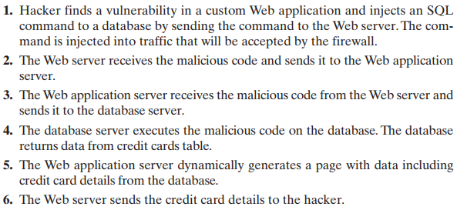

Slide 15
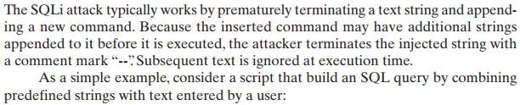


Slide 16
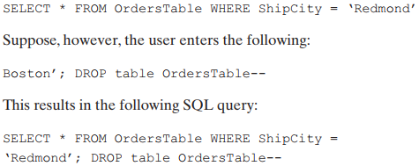
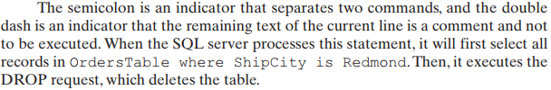

Slide 17
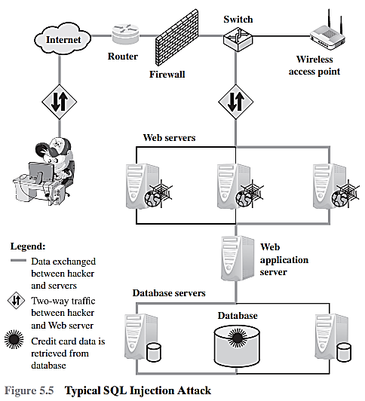
3 – Tier Architecture

Slide 18
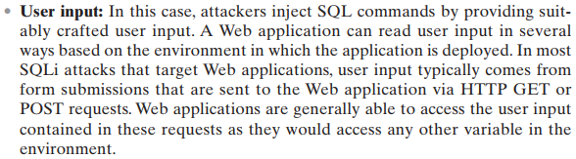
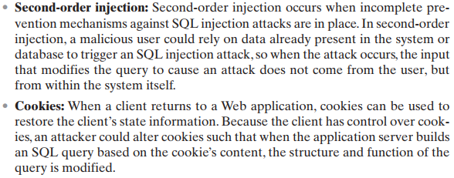
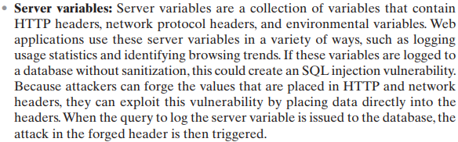
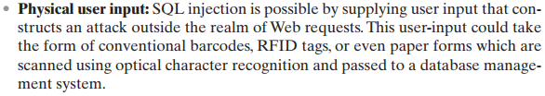

Slide 19
Attack types can be grouped into three main categories: inband, inferential, and out-of-band.
An in-band attack uses the same communication channel for injecting SQL code and retrieving results. The retrieved data are presented directly in the application webpage.
With an inferential attack, there is no actual transfer of data, but the attacker is able to reconstruct the information by sending particular requests and observing the resulting behavior of the website / database server.
In an out-of-band attack, data are retrieved using a different channel (e.g., an e-mail with the results of the query is generated and sent to the tester). This can be used when there are limitations on information retrieval, but outbound connectivity from the database server is lax.

Slide 20
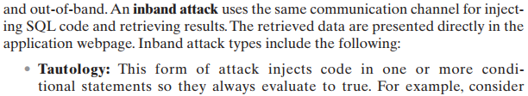

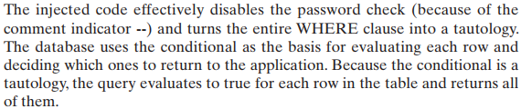
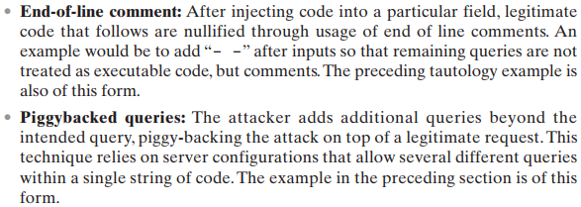

Slide 21
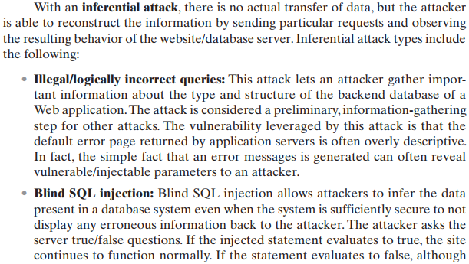

Slide 22

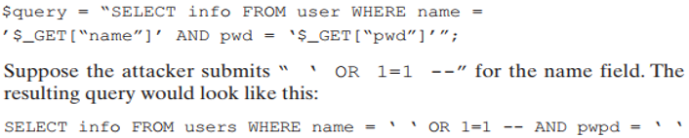
SQL Injection – Summary

Slide 23
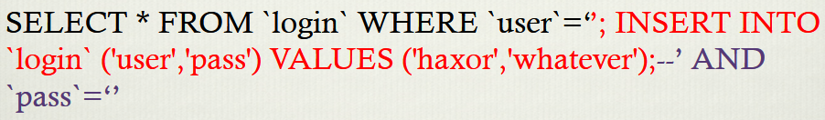
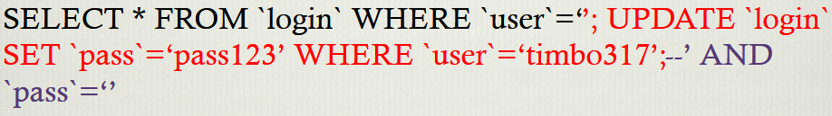
SQL Injection – Summary

Slide 24
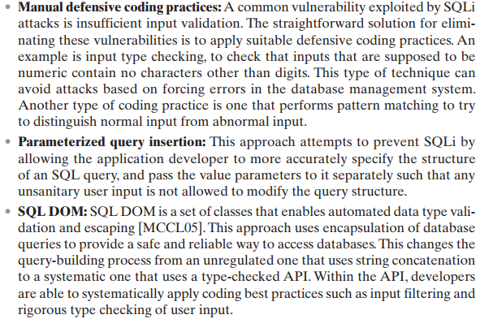
(1)

Slide 25
Prepared Statement: Example
http://java.sun.com/docs/books/tutorial/jdbc/basics/prepared.html
PreparedStatement ps =
db.prepareStatement("SELECT pizza, toppings, quantity, order_day "
+ "FROM orders WHERE userid=? AND order_month=?");
ps.setInt(1, session.getCurrentUserId());
ps.setInt(2, Integer.parseInt(request.getParamenter("month")));
ResultSet res = ps.executeQuery();
Bind variable (data placeholder)
Query parsed without parameters
Bind variables: ? placeholders guaranteed to be data (not control). Bind variables are typed (int, string, …)
Prepared statements allow creation of static queries with bind variables → preserves the structure of intended query
slide 25

Slide 26
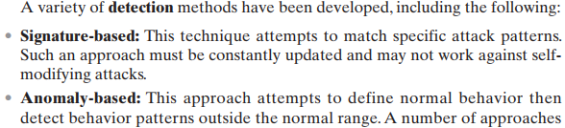
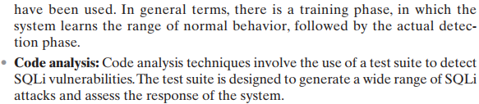
(2)

